Slide 1
Sales pitch for VS Code
Julian Geiger
Group seminar
29.06.2022

Slide 2
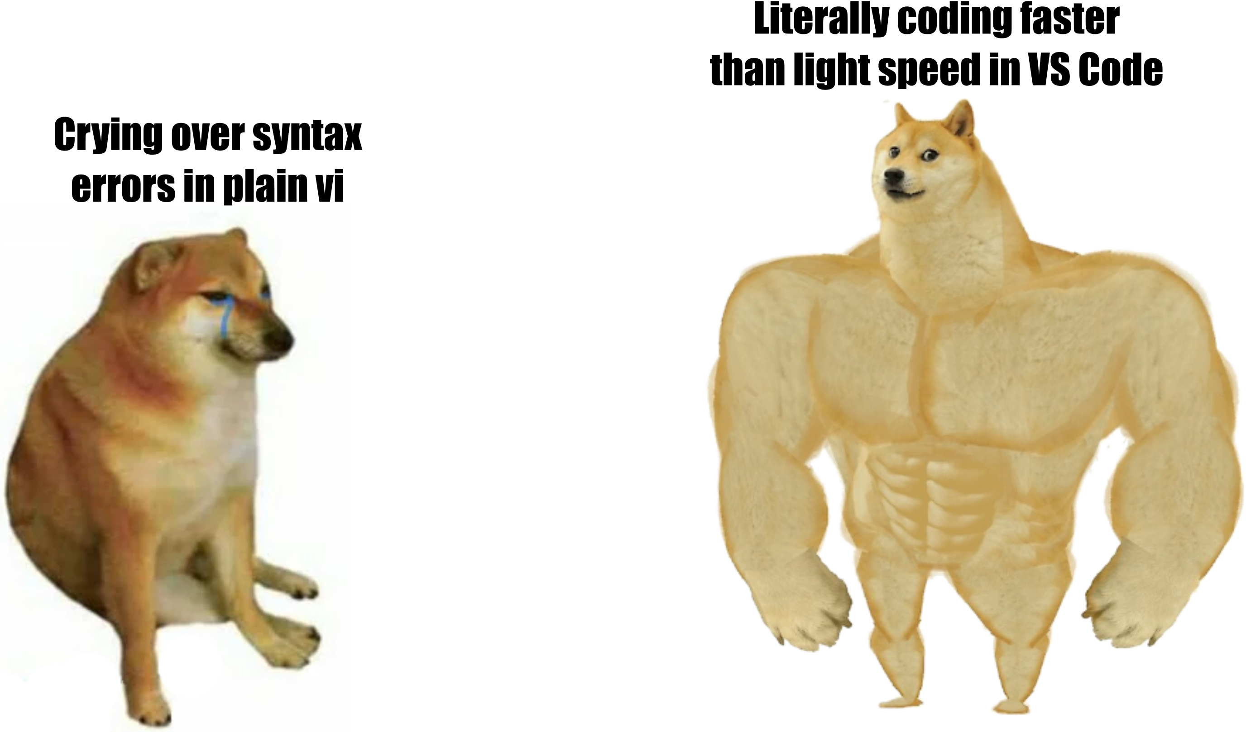
Motivation

Slide 3
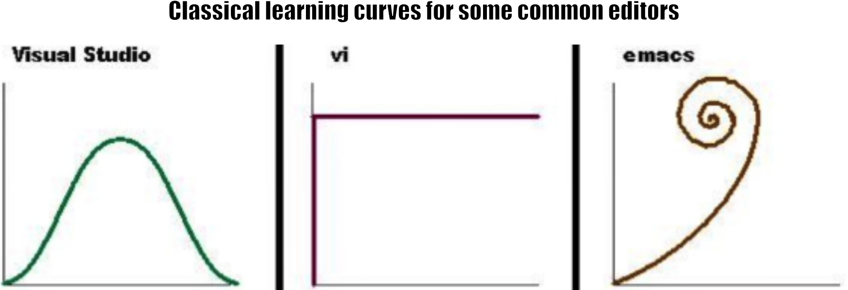
Motivation

Slide 4
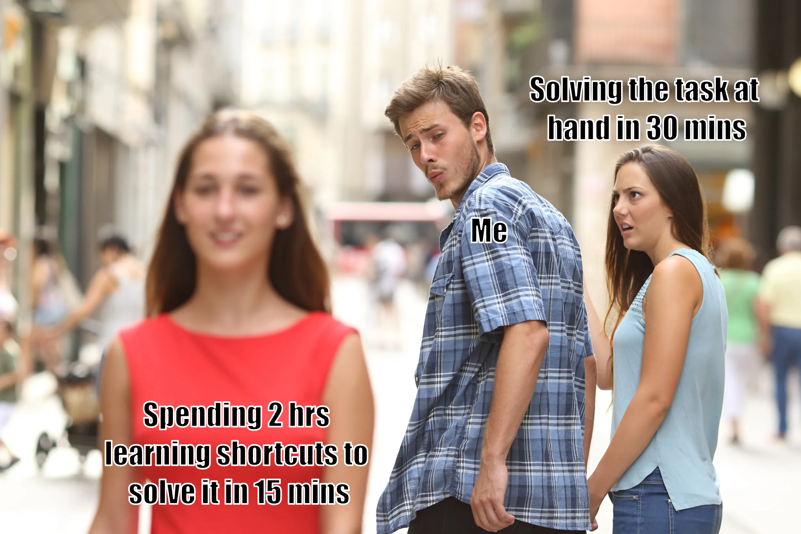
Motivation

